Slide 1
Model Context Protocol for .NET developers
Mike Kistler, PM MCP C# SDK
Allie Barry, PM Visual Studio

Slide 2
What is Model Context Protocol (MCP)
MCP is an open protocol created by Anthropic to enable integration between LLM applications and external tools & data sources.
Specification: https://modelcontextprotocol.io/specification/2025-06-18
Key Abstractions:
Host: this is the LLM/AI application
Client: Connects a Host to a Server
Server: Services that provide context and capabilities
Tools: Functions for the AI model to execute
Prompts: Templated messages and workflows for users
Resources: Context and data, for the user or the AI model to use
Notes:
MCP is being adopted broadly across the industry, including OpenAI, Google, Amazon, Hugging Face, and many other industry leaders. LLM uses trained information that happened in the past

Slide 3
Key Principles
Users must explicitly consent to and understand all data access and operations
Users must retain control over what data is shared and what actions are taken
Human in the Loop
Notes:
MCP servers shouldn’t see things it shouldn’t see. All actions need to be consented by the user.

Slide 4
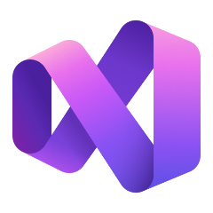



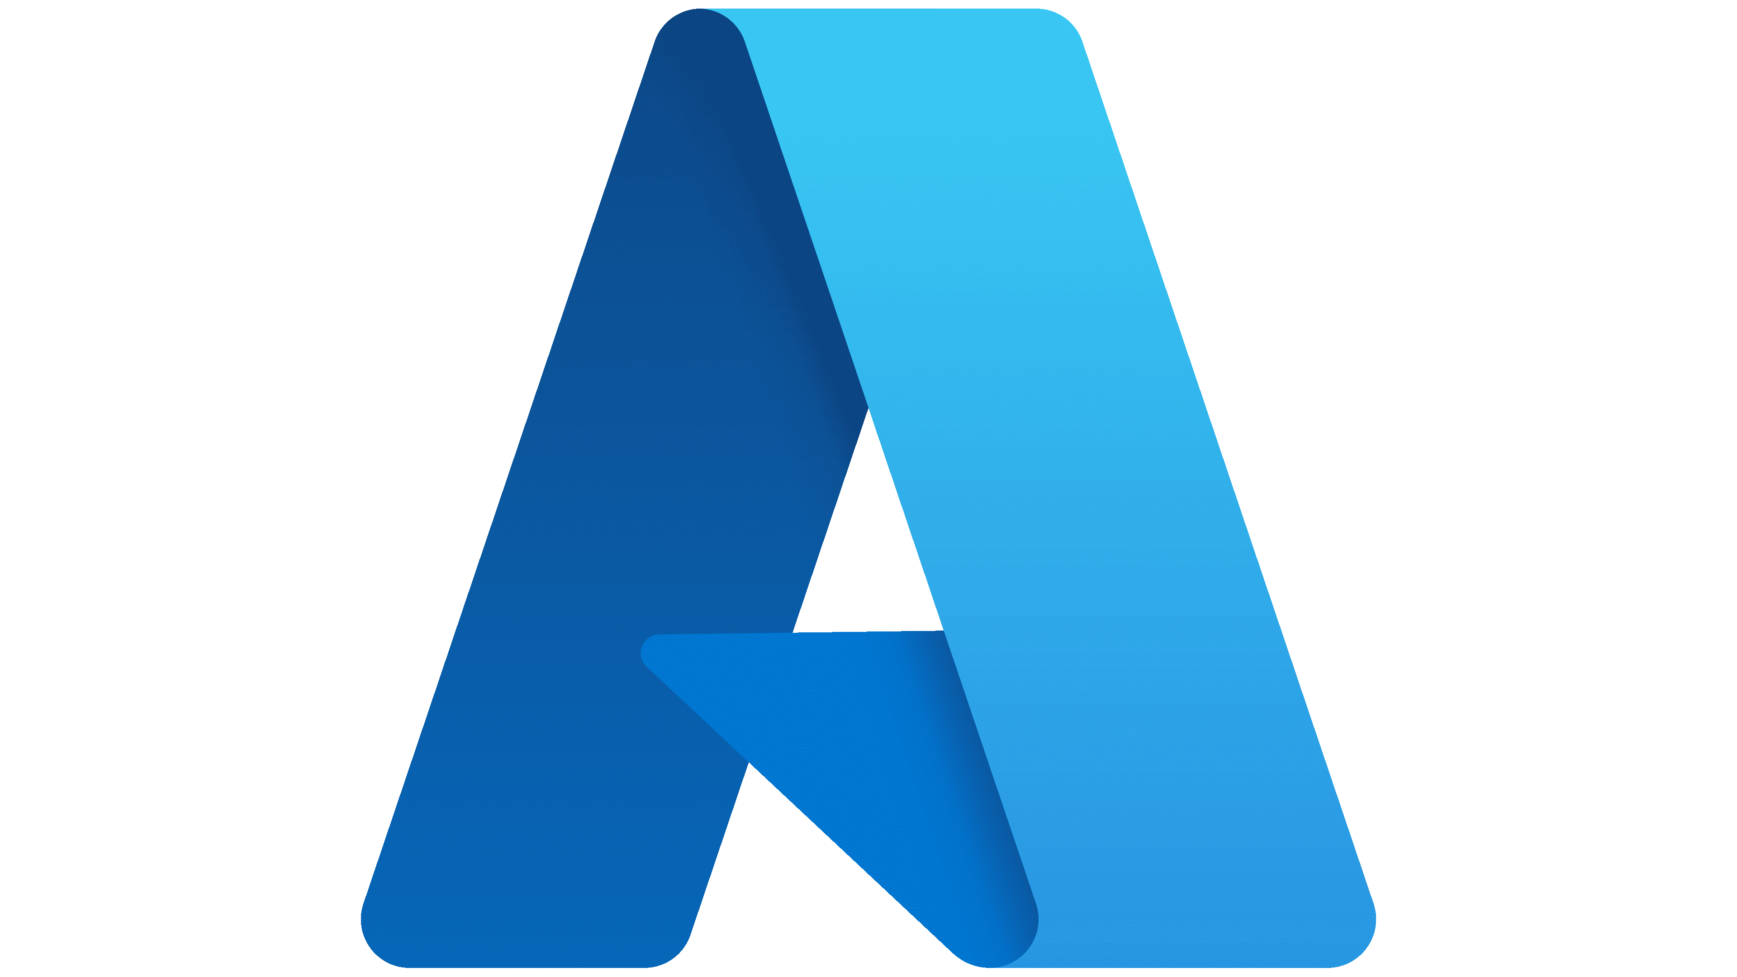


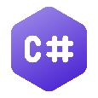
Model Context Protocol (MCP)
MCP Clients
Call tools
Request resources
Get prompts
MCP Servers
Expose tools
Expose resources
Expose prompts
Examples
Your agentic app
Your MCP sever
Microsoft Agent Framework
MCP C# SDK
Notes:
One of the key technologies we are building on with Agent Framework is Model Context Protocol, or MCP. MCP is a relatively new protocol, less than one year old still, that was originally created by Anthropic and is now being developed in an open collaboration of industry partners. The goal of MCP is to provide a standard mechanism to provide AI models with tools and resources, to extend their knowledge and capabilities to enable new and more powerful agentic applications.
MCP has already gained wide acceptance in the industry, with major players like AWS, Google, and OpenAI all announcing support for MCP.
And Microsoft is embracing MCP beyond Agent Framework. We have built MCP support into our development tools like Visual Studio and VS Code, and have developed MCP servers to plug into these systems such as the Microsoft Docs MCP server, the Azure MCP server, and the Playwright MCP server. GitHub also has an MCP server -- currently one of the most popular MCP servers. MCP support is also integrated directly into Windows to allow AI applications to connect with native Windows apps. And Azure API Management has new features to expose and govern MCP servers and control authentication, authorization, and monitoring.

Slide 5
What about C# ?
Microsoft is partnering with Anthropic to build the “official” MCP SDK for C#/.NET
Code: https://aka.ms/mcp-cs-sdk
Docs: https://modelcontextprotocol.github.io/csharp-sdk
Currently version 0.4.0-preview.4
Evolving rapidly – including occasional breaking changes
Goal is to faithfully implement the MCP spec (which is still evolving)
Used by many Microsoft products adding support for MCP servers
Notes:
Used by Copilot Studio, Visual Studio, Azure MCP Server, Microsoft Learn MCP Server, the Windows MCP server, and even more are in development.

Slide 6
Demo:
Building an MCP with C# in Visual Studio 2026 Using MCP servers in Visual Studio 2026

Slide 7
MCP Roadmap
New Spec Version 2025-11-25 (one year anniversary)
Enhance authorization server discovery with support for OpenID Connect Discovery 1.0. (PR #797)
Allow servers to expose icons as additional metadata for tools, resources, resource templates, and prompts (SEP-973).
Enhance authorization flows with incremental scope consent via WWW-Authenticate (SEP-835)
Provide guidance on tool names (SEP-986)
Many SEPs under consideration for the next version
Tasks
Better support for stateless servers
Improvements for server discovery
Open Process: GitHub and Discord

Slide 8
Demo:
Enterprise Governance of MCPs in Visual Studio

Slide 9
Questions ??

Slide 10
Thank You !!

